Slide 1
Machine Learning
Pytorch Tutorial 2
Documentation and Common Errors
TA : 許湛然（Chan-Jan Hsu）
2021.03.05

Slide 2
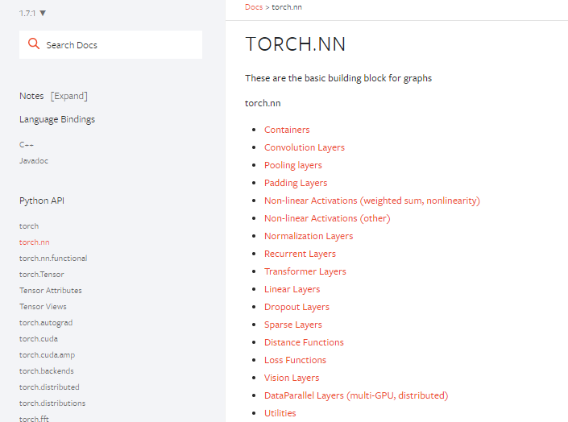
PyTorch Documentation
https://pytorch.org/docs/stable/
torch.nn -> neural network
torch.optim -> optimization algorithms
torch.utils.data -> dataset, dataloader

Slide 3
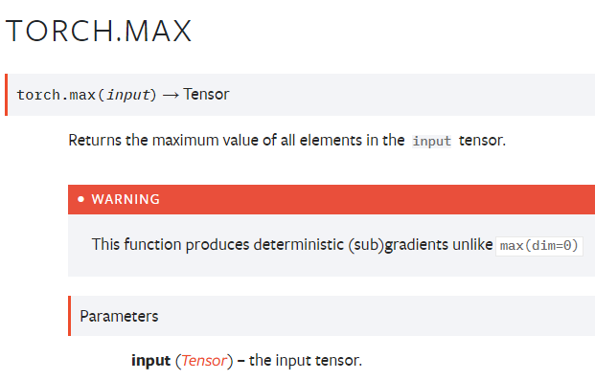
PyTorch Documentation Example
function inputs and outputs
data type and explanation of each input

Slide 4
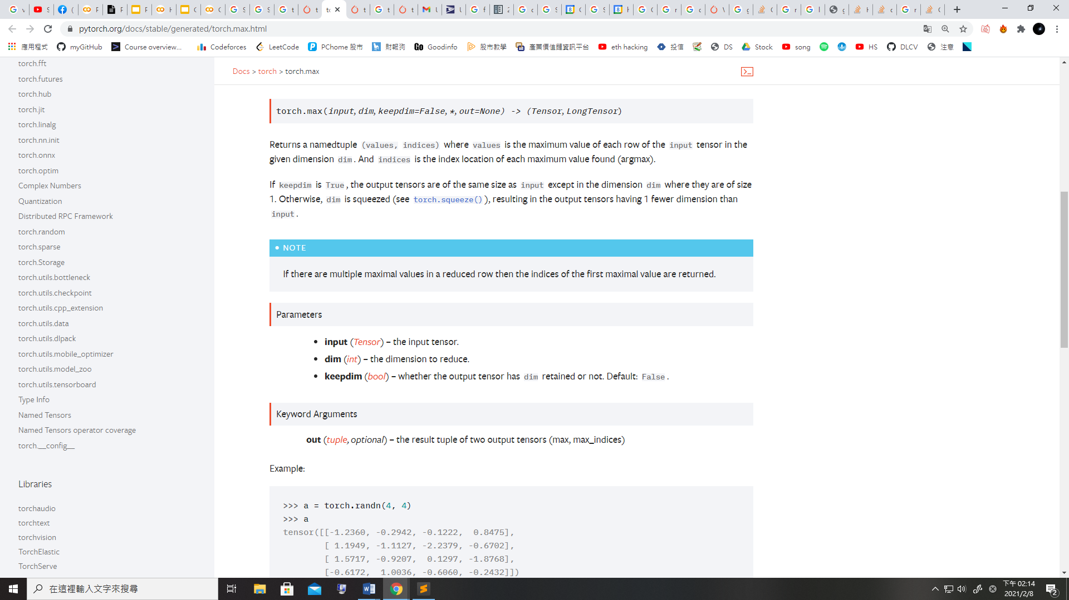
PyTorch Documentation Example
Some functions behave differently with different inputs
Parameters : You don’t need to specify the name of the argument
(Positional Arguments)
Keyword Arguments : You have to specify the name of the argument
They are separated by *

Slide 5
PyTorch Documentation Example
Some functions behave differently with different inputs
Arguments with default value :
Some arguments have a default value (keepdim=False), so passing a value of this argument is optional

Slide 6
PyTorch Documentation Example
Three Kinds of torch.max
torch.max(input) → Tensor
torch.max(input, dim, keepdim=False, *, out=None) → (Tensor, LongTensor)
torch.max(input, other, *, out=None) → Tensor
input : Tensor, dim : int, keepdim : bool
other : Tensor

Slide 7
PyTorch Documentation Example
1.torch.max(input) → Tensor
Find the maximum value of a tensor, and return that value.

Slide 8
PyTorch Documentation Example
2. torch.max(input, dim, keepdim=False, *, out=None) → (Tensor, LongTensor)
Find the maximum value of a tensor along a dimension, and return that value, along with the index corresponding to that value.

Slide 9
PyTorch Documentation Example
3.torch.max(input, other) → Tensor
Perform element-wise comparison between two tensors of the same size, and select the maximum of the two to construct a tensor with the same size.

Slide 10
PyTorch Documentation Example (Colab)
Three Kinds of torch.max
torch.max(input) → Tensor
torch.max(input, dim, keepdim=False, *, out=None) → (Tensor, LongTensor)
torch.max(input, other, *, out=None) → Tensor
input : Tensor
dim : int
keepdim : bool
other : Tensor
Colab code
x = torch.randn(4,5)
y = torch.randn(4,5)
m = torch.max(x)
m, idx = torch.max(x,0)→O
m, idx = torch.max(input = x,dim=0)→O
m, idx = torch.max(x,0,False)→O
m, idx = torch.max(x,0,keepdim=True)→O
m, idx = torch.max(x,0,False,out=p)→O
m, idx = torch.max(x,0,False,p)→x
*out is a keyword argument
m, idx = torch.max(x,True)→x
*did not specify dim
t = torch.max(x,y)

Slide 11
Common Errors -- Tensor on Different Device to Model
model = torch.nn.Linear(5,1).to("cuda:0")
x = torch.Tensor([1,2,3,4,5]).to("cpu")
y = model(x)
Tensor for * is on CPU, but expected them to be on GPU
=> send the tensor to GPU
x = torch.Tensor([1,2,3,4,5]).to("cuda:0")
y = model(x)
print(y.shape)

Slide 12
Common Errors -- Mismatched Dimensions
x = torch.randn(4,5)
y = torch.randn(5,4)
z = x + y
The size of tensor a (5) must match the size of tensor b (4) at non-singleton dimension 1
=> the shape of a tensor is incorrect, use transpose, squeeze, unsqueeze to align the dimensions
y = y.transpose(0,1)
z = x + y
print(z.shape)

Slide 13
Common Errors -- Cuda Out of Memory
import torch
import torchvision.models as models
resnet18 = models.resnet18().to("cuda:0") # Neural Networks for Image Recognition
data = torch.randn(512,3,244,244) # Create fake data (512 images)
out = resnet18(data.to("cuda:0")) # Use Data as Input and Feed to Model
print(out.shape)
CUDA out of memory. Tried to allocate 350.00 MiB (GPU 0; 14.76 GiB total capacity; 11.94 GiB already allocated; 123.75 MiB free; 13.71 GiB reserved in total by PyTorch)
=> The batch size of data is too large to fit in the GPU. Reduce the batch size.

Slide 14
Common Errors -- Cuda Out of Memory
If the data is iterated (batch size = 1), the problem will be solved. You can also use DataLoader
for d in data:
out = resnet18(d.to("cuda:0").unsqueeze(0))
print(out.shape)

Slide 15
Common Errors -- Mismatched Tensor Type
import torch.nn as nn
L = nn.CrossEntropyLoss()
outs = torch.randn(5,5)
labels = torch.Tensor([1,2,3,4,0])
lossval = L(outs,labels) # Calculate CrossEntropyLoss between outs and labels
expected scalar type Long but found Float
=> labels must be long tensors, cast it to type “Long” to fix this issue
labels = labels.long()
lossval = L(outs,labels)
print(lossval)

